Slide 1
Distributed Systems Design COMP 6231
﻿Consistency and replication – Part I
Lecture 09
Essam Mansour

Slide 2
Today…
Today’s Session:
Replication (or more precisely, server-side replication)
Data-Centric Consistency Models

Slide 3
Overview
Today’s lecture
Motivation
Consistency Models
Data-Centric Consistency Models
Client-Centric Consistency Models
Consistency Protocols
Next lecture

Slide 4
Overview
Motivation
Consistency Models
Data-Centric Consistency Models
Client-Centric Consistency Models
Consistency Protocols

Slide 5
Why Replication?
Replication is necessary for:
Improving performance
A client can access nearby replicated copies and save latency
Increasing the availability of services
Replication can mask failures such as server crashes and network disconnection
Enhancing the scalability of systems
Requests to data can be distributed across many servers, which contain replicated copies of the data
Securing against malicious attacks
Even if some replicas are malicious, security of data can be guaranteed by relying on replicated copies at non-compromised servers

Slide 6

1. Replication for Improving Performance
Example:
Replication at secondary servers in Content Delivery Network (CDNs)
Main Server
Secondary Servers

Slide 7
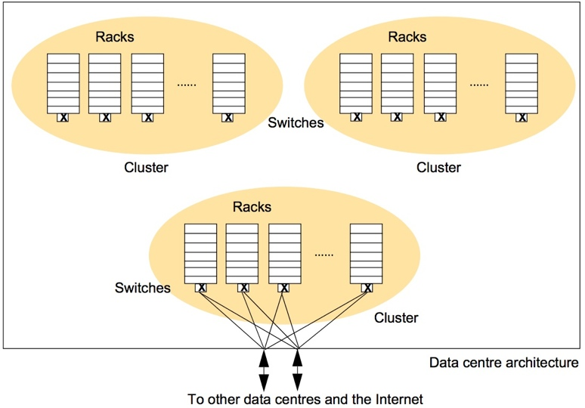
2. Replication for High-Availability
Example:
Google File-System replicates data blocks at computers across different racks, clusters, and data-centers
If one computer or a rack or a cluster crashes, blocks can still be accessed from other sources

Slide 8
3. Replication for Enhancing Scalability
Distributing data across replicated servers helps in saving the main server from becoming a performance bottleneck
Example: Content Delivery Networks can decrease load at main (primary) servers
Main Server
Replicated Servers

Slide 9
4. Replication for Securing Against Malicious Attacks
If a minority of servers in a system are malicious, the non-malicious servers can outvote the malicious ones
This technique can also be used to provide fault-tolerance against non-malicious but faulty servers
Example: In a peer-to-peer system, peers can coordinate to prevent delivering faulty data to the requester
1
5
6
3
7
0
4
2
Number of servers with correct data outvote the faulty servers
n
= Servers that do not
have the requested data
n
= Servers with correct data
n
= Servers with faulty data

Slide 10
Why Consistency?
But (server-side) replication comes with a cost, which is the necessity for maintaining consistency (or more precisely consistent ordering of updates)
Example:
A Bank Database
Event 1 = Add $1000
Event 2 = Add interest of 5%
1
2
Bal=2000
4
Bal=2100
Bal=1000
3
Bal=1000
Bal=1050
Bal=2050
Replicated Database

Slide 11
Overview
Motivation
Consistency Models
Data-Centric Consistency Models
Client-Centric Consistency Models
Consistency Protocols

Slide 12
Maintaining Consistency of Replicated Data
DATA-STORE
Replica 1
Replica 2
Replica 3
Replica n
x=0
x=2
x=5
x=2
x=5
x=0
x=0
x=5
x=2
x=0
x=5
x=2
Process 1
R(x)0
W(x)2
R(x)?
R(x)5
Process 2
R(x)?
R(x)0
R(x)2
Process 3
W(x)5
Strict Consistency
Data is always fresh
After a write operation, the update is propagated to all the replicas
A read operation will result in reading the most recent write
If read-to-write ratio is low, this leads to large overheads
P1
=Process P1
=Timeline at P1
R(x)b
=Read variable x;
Result is b
W(x)b
= Write variable x;
Result is b

Slide 13
Maintaining Consistency of Replicated Data (Cont’d)
DATA-STORE
Replica 1
Replica 2
Replica 3
Replica n
x=0
x=2
x=0
x=0
x=2
x=0
x=5
x=2
x=0
x=3
x=2
Process 1
R(x)0
W(x)2
R(x)?
R(x)5
Process 2
R(x)?
R(x)5
R(x)3
Process 3
W(x)5
Loose Consistency
Data might be stale
A read operation may result in reading a value that was written long back
Replicas are generally out-of-sync
The replicas may sync at coarse grained time, thus reducing the overhead
P1
=Process P1
=Timeline at P1
R(x)b
=Read variable x;
Result is b
W(x)b
= Write variable x;
Result is b

Slide 14
Trade-offs in Maintaining Consistency
Maintaining consistency should balance between the strictness of consistency versus efficiency (or performance)
Good-enough consistency depends on your application
Loose Consistency
Strict Consistency
Easier to implement, and is efficient
Generally hard to implement, and is inefficient

Slide 15
Consistency Model
A consistency model is a contract between:
The process that wants to use the data
and the data-store
A consistency model states the level (or degree) of consistency provided by the data-store to the processes while reading and writing data

Slide 16
Types of Consistency Models
Consistency models can be divided into two types:
Data-Centric Consistency Models
These models define how updates are propagated across the replicas to keep them consistent
Client-Centric Consistency Models
These models assume that clients connect to different replicas at different times
They ensure that whenever a client connects to a replica, the replica is brought up to date with the replica that the client accessed previously

Slide 17
Overview
Motivation
Consistency Models
Data-Centric Consistency Models
Client-Centric Consistency Models
Consistency Protocols

Slide 18
Consistent Ordering of Operations
We need to express the semantics of parallel accesses when shared data are replicated
Before updates at replicas are committed, all replicas shall reach an agreement on a global ordering of the updates
That is, replicas in shared data-stores should agree on a consistent ordering of updates
What consistent ordering of updates can replicas agree on?

Slide 19
Types of Ordering
Below are three major types of orderings:
Total Ordering
Sequential Ordering
Sequential Consistency Model
Causal Ordering
Causal Consistency Model

Slide 20
Types of Ordering
Below are three major types of orderings:
Total Ordering
Sequential Ordering
Sequential Consistency Model
Causal Ordering
Causal Consistency Model

Slide 21
Total Ordering
What is total ordering?
If process P_{i} sends a message m_{i} and P_{j} sends m_{j}, and if one correct process delivers m_{i} before m_{j} then every other correct process delivers m_{i} before m_{j}
Messages can denote replica updates
In the example Ex1, if P₁ issues the operation m_{(1,1)}: x=x+1; and
If P₃ issues m_{(3,1)}: print(x); and
P₁ or P₂ or P₃ delivers m_{(3,1)} before m_{(1,1)}
Then, at all replicas P_{1,} P_{2,} P₃ the following order of operations are executed
print(x);
x=x+1;
P1
P2
P3
m_{(1,1)}
m_{(3,1)}
Ex1: Total Order
P1
P2
P3
m_{(1,1)}
m_{(3,1)}
Ex2: Not in Total Order

Slide 22
Types of Ordering
Below are three major types of orderings:
Total Ordering
Sequential Ordering
Sequential Consistency Model
Causal Ordering
Causal Consistency Model

Slide 23

Sequential Ordering
What is sequential ordering?
If a process Pi sends a sequence of messages m_{(i,1)},...., m_{(i,ni)}, and
Process Pj sends a sequence of messages m_{(j,1)},...., m_{(j,nj)},
Then:
At any process, the set of messages received are in some sequential order
Messages from each individual process should appear in the same order sent by that process
At every process, m_{i,1} should be delivered before m_{i,2}, which should be delivered before m_{i,3} and so on...
At every process, m_{j,1} should be delivered before m_{j,2}, which should be delivered before m_{j,3} and so on...
P1
P2
P3
m(1,1)
m(3,1)
m(3,2)
m(1,2)
m(3,3)
Valid Sequential Orders
P1
P2
P3
m(1,1)
m(3,1)
m(3,2)
m(1,2)
m(3,3)
Invalid Sequential Orders, but Valid Total Order

Slide 24
Sequential Consistency (Cont’d)
Consider three processes P₁, P₂ and P₃ executing multiple instructions on three shared variables x, y and z
Assume that x, y and z are set to zero at start
There are many valid sequences in which operations can be executed, respecting sequential consistency (or program order)
How can a program identify the wrong sequence among the following sequences:
P1
P2
P3
x = 1
print (y,z)
y = 1
print (x,z)
z = 1
print (x,y)
x = 1
print (y,z)
y = 1
print (x,z)
z = 1
print (x,y)
x = 1
y = 1
print (x,z)
print (y,z)
z = 1
print (x,y)
print (y,z)
y = 1
print (x,y)
x = 1
print (x,z)
z = 1
y = 1
z = 1
print (x,y)
print (x,z)
x = 1
print (y,z)
Output
001011
101011
000110
010111
Signature
001011
101011
001001
110101

Slide 25

Implications of Adopting A Sequential Consistency Model for Applications
There might be several different sequentially consistent combinations of ordering
Number of combinations for a total of n instructions =
The contract between the process and the distributed data-store is that the process must accept all of the sequential orderings as valid results
A process that works for some of the sequential orderings and not for others is INCORRECT
$$O(n!)$$

Slide 26
Types of Ordering
Below are three major types of orderings:
Total Ordering
Sequential Ordering
Sequential Consistency Model
Causal Ordering
Causal Consistency Model

Slide 27
Causal vs. Concurrent events
Consider an interaction between processes P₁ and P₂ operating on replicated data x and y
P1
W(x)a
P1
W(x)a
P2
R(x)a
W(y)b
P2
W(y)b
R(x)a
Events are causally related
Events are not concurrent
Computation of y at P₂ may have depended on the value of x written by P₁
Events are not causally related
Events are concurrent
Computation of y at P₂ does not depend on the value of x written by P₁
P1
=Process P1
=Timeline at P1
R(x)b
=Read variable x;
Result is b
W(x)b
= Write variable x;
Result is b

Slide 28
Causal Ordering
What is causal ordering?
If process P_{i} sends a message m_{i} and P_{j} sends m_{j}, and if m_{i}→m_{j} (operator ‘→’ is Lamport’s happened-before relation) then any correct process that delivers m_{j} will deliver m_{i} before m_{j}
In Ex1:
m_{(1,1)} and m_{(3,1)} are in Causal Order
m_{(1,1)} and m_{(1,2)} are in Causal Order
In Ex2:
m_{(1,1)} and m_{(3,1)} are NOT in Causal Order
P1
P2
P3
m_{(1,1)}
m_{(3,1)}
m_{(1,2)}
Ex1: Valid Causal Orders
P1
P2
P3
m_{(1,1)}
m_{(3,1)}
m_{(1,2)}
Ex2: Invalid Causal Order

Slide 29
Causal Consistency Model
A data-store is causally consistent if:
Writes that are potentially causally related are seen by all the processes in the same order
But concurrent writes may be seen in a different order on different machines

Slide 30
Implications of adopting a Causally Consistent Data-store for Applications
Processes have to keep track of which processes have seen which writes
This requires maintaining a dependency graph between write and read operations
Vector clocks provide a way to maintain causally consistent data-stores

Slide 31
Next Class
Consistency Models
Client-Centric Consistency Models
Consistency Protocols
We will study various implementations of consistency models

